Slide 1
Java Capability
Day 3 Java

Slide 2
Agenda
String
StringBuilder and StringBuffer
Arrays
Command line arguments
Parameter passing
Packages
Java Code Conventions

Slide 3
Prerequisites
Knowledge on OOP.
Basic programming.

Slide 4
Strings
String is a sequence of characters, for e.g. “HCL” is a string of 3 characters.
In Java programming language, strings are treated as objects.
String is a Final class; i.e once created the value cannot be altered. Thus String objects are called immutable.
The String Class extends the Object class.
There are two ways to create a String in Java
String literal
Using new keyword
The java.lang.String class implements Serializable, Comparable and CharSequence interfaces.

Slide 5
String literal
String literal is created by using double quotes.
String str=“Welcome";
Each time you create a string literal, the JVM checks the string constant pool first.
If the string already exists in the pool, a reference to the pooled instance is returned.
If string doesn't exist in the pool, a new string instance is created and placed in the pool.

Slide 6
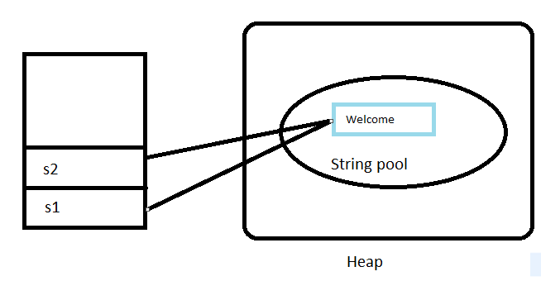
String literal Cont.
String s1="Welcome";
String s2="Welcome"; //will not create new instance

Slide 7
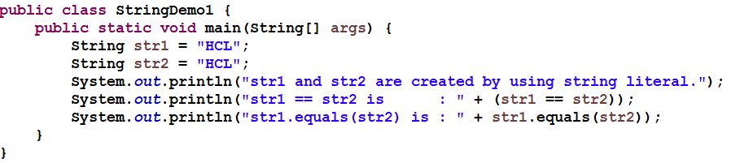
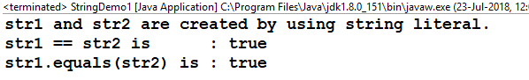
String literal Cont.
The equals method compares the content of two objects rather than two objects' references.
The == operator with reference types (i.e., Objects) evaluates as true if the references are identical - point to the same object.

Slide 8
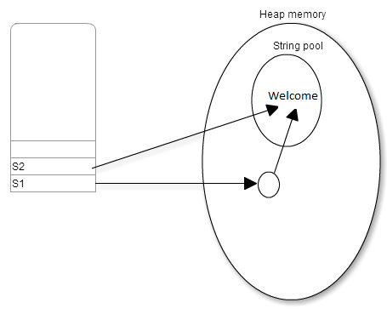
String Using new keyword
In string object new keyword will be used to create an object.
Example: String s1=new String("Welcome");
JVM will create a new string object in normal(non pool) heap memory and the literal "Welcome" will be placed in the string constant pool. The variable ‘s1’ will refer to the object in heap(non pool).
The object will be created in Heap memory and its reference will be pointed to String pool.
String s2=“Welcome”;
String s1=new String("Welcome");

Slide 9
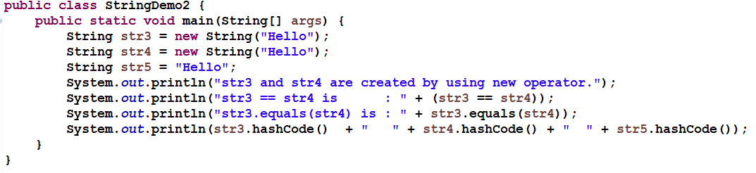
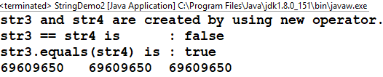
String Using new keyword - Example

Slide 10
Java String Methods
No. | Method | Description
1 | char charAt(int index) | returns char value for the particular index
2 | int length() | returns string length
3 | static String format(String format, Object... args) | returns formatted string
4 | static String format(Locale l, String format, Object... args) | returns formatted string with given locale
5 | String substring(int beginIndex) | returns substring for given begin index
6 | String substring(int beginIndex, int endIndex) | returns substring for given begin index and end index
7 | boolean contains(CharSequence s) | returns true or false after matching the sequence of char value

Slide 11
Java String Methods cont.
ll | static String join(CharSequence delimiter, CharSequence... elements) | returns a joined string
9 | static String join(CharSequence delimiter, Iterable<? extends CharSequence> elements) | returns a joined string
10 | boolean equals(Object another) | checks the equality of string with object
11 | boolean isEmpty() | checks if string is empty
12 | String concat(String str) | concatinates specified string
13 | String replace(char old, char new) | replaces all occurrences of specified char value
14 | String replaceAll(CharSequence old, CharSequence new) | replaces all occurrences of specified CharSequence
15 | static String equalsIgnoreCase(String another) | compares another string. It doesn't check case.
16 | String[] split(String regex) | returns splitted string matching regex
No. | Method | Description

Slide 12
Methods of String
length( ) | concat(String) | toUpperCase( ) | toLowerCase( ) | lastIndexOf(char)
charAt(index) | indexOf(char) | indexOf(char, pos) | trim( ) | lastIndexOf(char,pos)
toCharArray( ) | split(delimiter) | valueOf(non_str) | equals(str) | equalsIgnoreCase(str)

Slide 13
String charAt Example
public class CharAtExample {
public static void main(String args[]) {
String str = "Welcome to string handling tutorial";
char ch1 = str.charAt(0);
char ch2 = str.charAt(5);
char ch3 = str.charAt(11);
char ch4 = str.charAt(20);
System.out.println("Character at 0 index is : “ + ch1);
System.out.println("Character at 5th index is : “ + ch2);
System.out.println("Character at 11th index is: “ + ch3);
System.out.println("Character at 20th index is: “ + ch4);
}
}
Output:
Character at 0 index is: W
Character at 5th index is: m
Character at 11th index is: s
Character at 20th index is: n

Slide 14
String concat Example
public class ConcatenationExample {
public static void main(String args[]) {
String str1 = "Welcome";
str1 = str1.concat(" to ");
str1 = str1.concat(" String handling ");
System.out.println(str1);
String str2 = "This";
str2 = str2.concat(" is").concat(" just a").concat(" String");
System.out.println(str2);
}
}
Output:
Welcome to String handling
This is just a String

Slide 15
String length Example
public class LengthExample{
public static void main(String args[]) {
String str1= new String("Test String");
String str2= new String("Chaitanya");
String str3= new String(“HCL");
System.out.println("Length of str1 : “ + str1.length( ) );
System.out.println("Length of str2 : “ + str2.length( ) );
System.out.println("Length of str3 : “ + str3.length( ) );
}
}
Output:
Length of str1:11
Length of str2:9
Length of str3:3

Slide 16
String equals Example
public class EqualsExample1{
public static void main(String[ ] args){
String str1= new String("Hello");
String str2= new String("Hi");
String str3= new String("Hello");
System.out.println("str1 equals to str2 : “ + str1.equals(str2));
System.out.println("str1 equals to str3 : “ + str1.equals(str3));
System.out.println("str1 equals to Hello: “ + str1.equals("Hello"));
System.out.println("str1 equals to hello: “ + str1.equals("hello"));
}
}
Output:
str1 equals to str2:false
str1 equals to str3:true
str1 equals to Hello:true
str1 equals to hello:false

Slide 17
String equalsIgnoreCase Example
public class EqualsExample2{
public static void main(String args[]){
String str1= new String("Apple");
String str2= new String("MANGO");
String str3= new String("APPLE");
System.out.println("str1 equals to str2 : “ + str1.equalsIgnoreCase(str2));
System.out.println("str1 equals to str3 : “ + str1.equalsIgnoreCase(str3));
System.out.println("str1 equals to Apple: “ + str1.equalsIgnoreCase("Apple"));
System.out.println("str2 equals to mango:“ + str2.equalsIgnoreCase("mango"));
}
}
Output:
str1 equals to str2:false
str1 equals to str3:true
str1 equals to Apple:true
str2 equals to mango:true

Slide 18
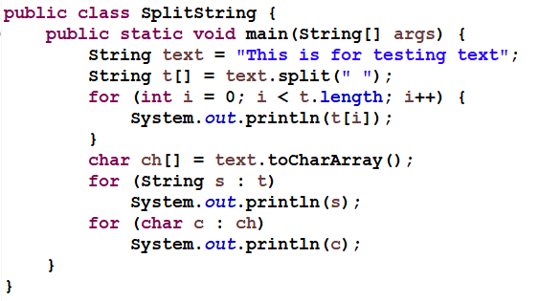
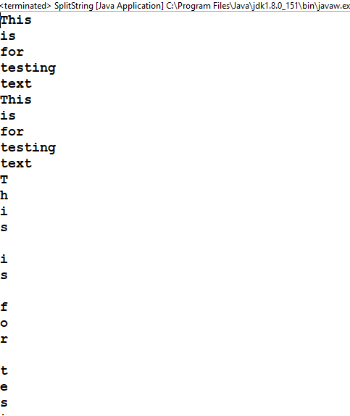
String Split Example

Slide 19
String compareTo() Example
Consider two string named s1 and s2.
s1 > s2, it returns positive number
if s1 < s2, it returns negative number
if s1 == s2, it returns 0
Example:
public class CompareToExample{
public static void main(String args[]){

Slide 20
String compareTo() Example contd..
String s1="hello";
String s2="hello";
String s3="meklo";
String s4="hemlo";
String s5="flag";
System.out.println(s1.compareTo(s2) ) ; //0 because both are equal
System.out.println(s1.compareTo(s3) ); //-5 because "h" is 5 times lower than "m"
System.out.println(s1.compareTo(s4) ); //-1 because "l" is 1 times lower than "m"
System.out.println(s1.compareTo(s5) ); //2 because "h" is 2 times greater than "f"
}
}
Output:
0
-5
-1
2

Slide 21
Difference between == and equals
== checks if both objects point to the same memory location whereas .equals() evaluates to the comparison of values/content in the objects.
public class Test {
public static void main(String[] args)
{
String s1 = new String("HELLO");
String s2 = new String("HELLO");
System.out.println(s1 == s2);
System.out.println(s1.equals(s2));
}
}
Output:
false
true

Slide 22
String toCharArray Example
public class CharArrayExample{
public static void main(String args[]){
String str = new String("Welcome to HCL");
char[ ] array= str.toCharArray();
System.out.print("Content of Array:");
for(char c: array){
System.out.print(c);
}
}
}
Output:
Content of Array:
Welcome to HCL

Slide 23
StringBuffer
StringBuffer is an extended way of handling string.
StringBuffer class is the mutable class.
Dynamic changes of string are applicable with the help of StringBuffer.
String is of fixed length, where as string buffer is of varying length.
String buffer allocates additional 16 bytes of space in addition to current string length. (each letter is 1 byte)

Slide 24
StringBuffer
Methods of StringBuffer
length()
append(String)
capacity()
insert(int, String)
delete(start_index, no_of_chars)
reverse()

Slide 25
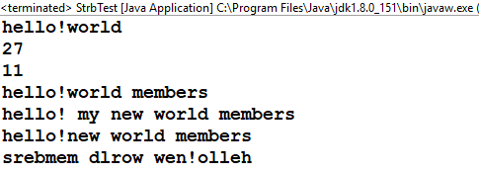
Example
class StrbTest{
public static void main(String ar[]){
String str="hello!world";
StringBuffer sb = new StringBuffer(str);
System.out.println(sb);
System.out.println(sb.capacity());
System.out.println(sb.length());
System.out.println(sb.append(" members"));
System.out.println(sb.insert(6," my new ") );
System.out.println(sb.delete(6,10));
System.out.println(sb.reverse());
}
}

Slide 26
StringBuilder
Java StringBuilder class is used to create mutable (modifiable) string.
This is similar to StringBuffer with respect to methods and implementation.
Difference between StringBuffer and StringBuilder is synchronization.
StringBuffer is synchronized
StringBuilder is not synchronized.
Rest of the functionalities are almost similar.

Slide 27
StringBuilder - Demo
Demo 1 : class StringBuilderExample{
public static void main(String args[]){
StringBuilder sb=new StringBuilder("Hello ");
sb.append("Java"); //now original string is changed
System.out.println(sb);//prints Hello Java
}
}
Demo 2 : class StringBuilderExample2{
public static void main(String args[]){
StringBuilder sb=new StringBuilder("Hello");
sb.replace(1,3,"Java");
System.out.println(sb);//prints HJavalo
}
}

Slide 28
ARRAYS
An array is a container object that holds a fixed number of values of a single type.
When an array is created, the length of an array is fixed.
Array elements are automatically initialized with the default value of their type, When an array is created.
Array can be created using the new keyword.
Ex:
int[ ] x = new int[5]; // defining an integer array for 5 blocks
Notes:
28
Arrays are objects in java. All Java arrays are technically one-dimensional. Two-dimensional arrays are arrays of arrays. Declaring an array does not create an array object or allocate space in memory; it creates a variable with a reference to an array.
Array variable declarations must indicate a dimension by using [].
Examples of valid array declarations:
int[] a;
int []a;
int a[];
int [] a;
By default array elements are initialized as follows:
int 0
float 0.0f
double 0.0
char ‘\u0000’(UNICODE character null)
Boolean false
Object null

Slide 29
ARRAYS CONT.
Alternatively, we can create and initialize array as below format
int[ ] x = { 10, 20, 30 };
int[ ] x = new int[ ]{ 10, 20, 30 };
Here the length of an array is determined by the number of values provided between { and }
The built-in length property determines the size of any array
Ex:
int[ ] x = new int[10];
int x_len = x.length;
Notes:
29

Slide 30
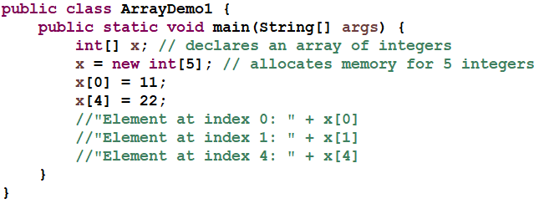
ARRAY - EXAMPLE
Notes:
30

Slide 31
ARRAY BOUNDS,ARRAY RESIZING
Array subscripts begin with index of 0(zero).
Can't access an array element beyond the range.
Can't resize an array. Can use the same reference variable to refer new array.
int x[ ] = new int [5];
x= new int [10];
Notes:
31
Once an array is defined cannot be resized or redefined to store a different type of data. If we use the same reference to refer to a new array object, we will lose the previous array object which was referred by the same reference.

Slide 32
ARRAY COPY
To copy array elements from one array to another array, we can use arraycopy static method from System class.
Syntax:
public static void arraycopy(Object s,int sIndex,Object d,int dIndex,int lngth)
Ex:
int source[ ] = {1, 2, 3, 4, 5, 6};
int dest[ ] = new int[10];
System.arraycopy(source,0, dest,0,source.length);
Notes:
32
Java's API class contains a class called System, which in turn contains a method called arraycopy(). This method is used to copy data from an array into another array. We have to pass parameters to this method. The syntax is
public static void arraycopy(source, source-index, destination, destination-index, length)
source is the source array from where we are going to copy elements.
destination is the array to where we are going to copy elements.
source-index tells us starting location from where copy will begin.
destination-index is about starting location in the destination array.

Slide 33
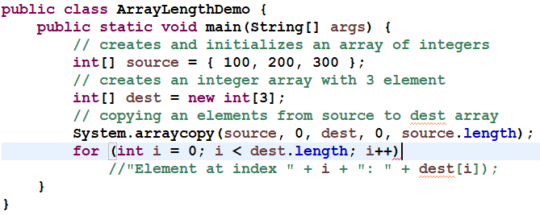
ARRAY COPY - EXAMPLE
Notes:
33

Slide 34
TWO DIMENSIONAL - ARRAY
Two-dimensional arrays are arrays of arrays
int[ ][ ] y = new int[3][3];
The 1st dimension represent rows or number of one dimension, the 2nd dimension represent columns or number of elements in the each one dimensions
The curly braces { } may also be used to initialize two dimensional arrays
Ex:
int[ ][ ] y = { {1,2,3}, {4,5,6}, {7,8,9} };
int[ ][ ] y = new int[3][ ] { {1,2,3}, {4,5,6}, {7,8,9} };
Notes:
34
But, int[][] x = new int[][3]; is illegal.
Program to demonstrate two-dimensional arrays:
class TwoDimDemo {
// initialize number of rows
static int [][] x = new int[3][];
public static void main(String[] args) {
x[0] = new int[3]; // initialize number of cols
x[1] = new int[4]; // in each row
x[2] = new int[5];
for(int i=0; i<x.length; i++) { // fill and print the array
for (int j=0; j<x[i].length; j++) {
x[i][j] = i;
System.out.print(x[i][j]);
}
System.out.println();
}
} // end main()
}
Output:
000
1111
22222

Slide 35
TWO DIMENSIONAL ARRAY CONTD….
You can initialize the row dimension without initializing the columns but not vice versa.
int[][] x = new int[3][];
int[][] x = new int[][3]; //error
The length of the columns can vary for each row and initialize number of columns in each row.
Ex1:
int [][]x = new int [2][];
x[0] = new int[4];
x[1] = new int [3];
x
0
0 0 0 0
1
0 0 0
Notes:
35

Slide 36
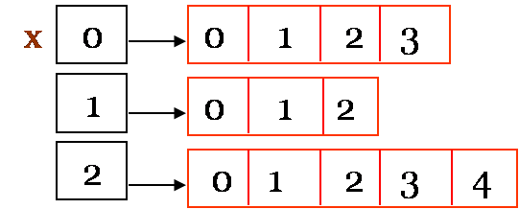
TWO DIMENSIONAL ARRAY CONTD….
Ex2:
int [ ][ ]x = new int [3][ ];
x[0] = new int[ ]{ 0,1,2,3 };
x[1] = new int [ ]{ 0,1,2 };
x[2] = new int[ ]{ 0,1,2,3,4 };
Notes:
36

Slide 37
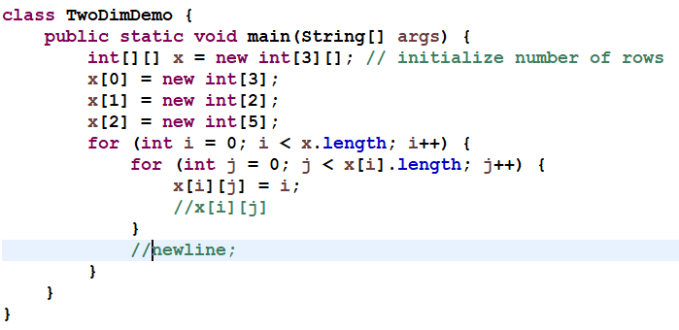
TWO DIMENSIONAL ARRAY - EXAMPLE
Notes:
37

Slide 38
QUIZ
Select which of the following are valid array definition
int[ ] a;
a = new int[5];
int a[ ] = new int[5];
int a[5] = new int[5];
int a[ ] = {1,2,3};
int[ ] a = new int[ ]{1,2,3};
int[ ] a = new int[5]{1,2,3,4};
Notes:
Answer: 1,2,4 and 5
38

Slide 39
QUIZ
Predict the output
class Sample{
public static void main(String[ ] args){
int[ ] a = new int[5]{1,2,3};
for(int i : a){
System.out.println(i);
}
}
}
Notes:
Answer:
Error: Invalid array object creation
39

Slide 40
For-each loop in Java
For-each is another array traversing technique like for loop, while loop, do-while loop introduced in Java5.
Syntax
for (type var : array)
{
statements using var;
}
It starts with the keyword for like a normal for-loop.
Instead of declaring and initializing a loop counter variable, you declare a variable that is the same type as the base type of the array, followed by a colon, which is then followed by the array name.
In the loop body, you can use the loop variable you created rather than using an indexed array element.
It’s commonly used to iterate over an array or a Collections class (eg, ArrayList)

Slide 41
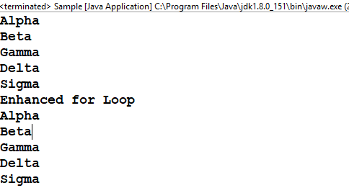
For-each loop in Java - Demo
public class Sample {
public static void main(String[] args) {
String[] arrData = { "Alpha", "Beta", "Gamma", "Delta", "Sigma" };
for (int i = 0; i < arrData.length; i++) {
System.out.println(arrData[i]);
}
System.out.println("Enhanced for Loop");
for (String strTemp : arrData) {
System.out.println(strTemp);
}
}
}

Slide 42
Command Line Argument
Command Line Argument is information passed to the program when you run the program.
The passed information is stored as a string array in the main method.
There is no restriction on the number of java command line arguments.

Slide 43
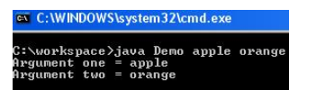
Command Line Argument cont.
Step 1) Open a notepad or text editor
class Demo{
public static void main(String b[ ]){
System.out.println("Argument one = "+b[0]);
System.out.println("Argument two = "+b[1]);
}
}
Step 2) Save & Compile the code
cmd > javac Demo.java Step 3) Run the code as
cmd > java Demo apple orange

Slide 44
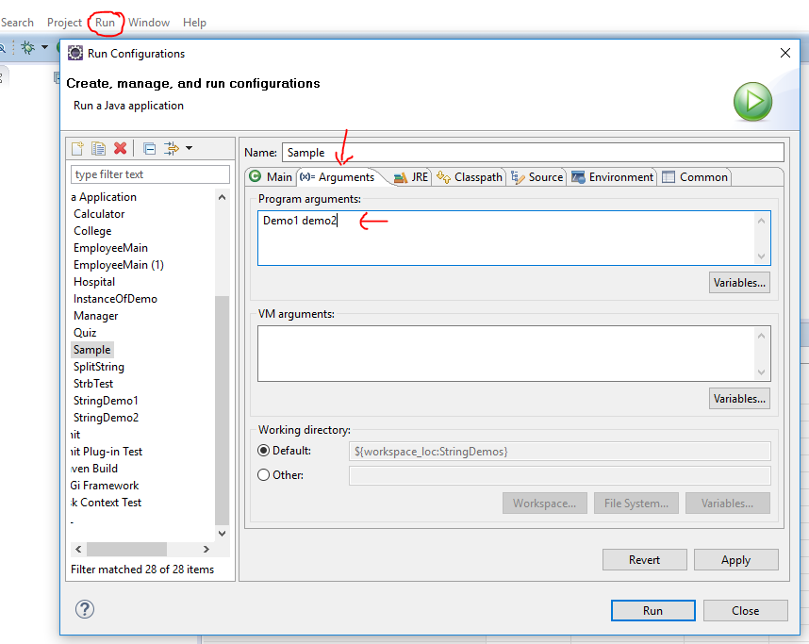
Eclipse command line arguments
Eclipse menu → Click on Run -> Run Configurations
Click on Arguments tab
In Program Arguments section , Enter your arguments.
Click Apply

Slide 45
Parameter passing
Java handles parameters in methods. Ex : void swap(int num1, int num2).
languages support two parameter passing techniques namely:
pass-by-value and
pass-by-reference.
In pass-by-value technique, the actual parameters in the method call are copied to the dummy parameters in the method definition. So, whatever changes are performed on the dummy parameters, they are not reflected on the actual parameters.
In pass-by-reference technique, reference (address) of the actual parameters are passed to the dummy parameters in the method definition. So, whatever changes are performed on the dummy parameters, they are reflected on the actual parameters too as both references point to same memory locations containing the original values.

Slide 46
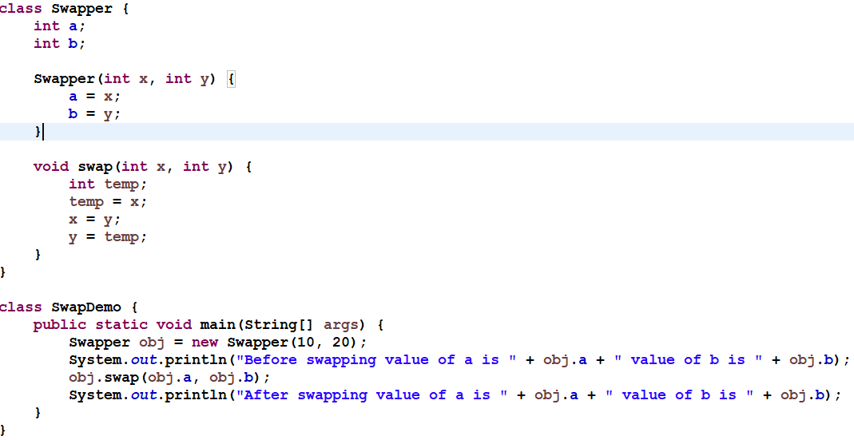
pass-by-value

Slide 47
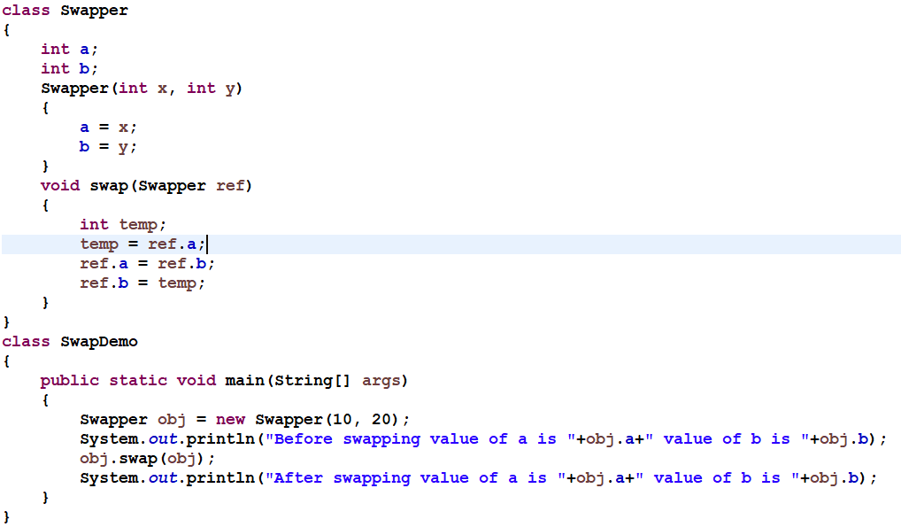
pass-by-reference

Slide 48
Packages in java
A package is a pack(group) of classes, interfaces and other packages.
Java package removes naming collision.
There are two types of packages in Java
Built-in packages.
User defined package.
Built-in packages
Ex : import java.util.Scanner
java is a top level package.
util is a sub package.
and Scanner is a class which is present in the sub package util.

Slide 49
Create PACKAGE in Java
Syntax : package nameofpackage;
Package names are written in all lower case to avoid conflict with the names of classes or interfaces.
Companies use their reversed Internet domain name to begin their package names—for example : com.hcl.mypackage
Package must be the first statement in the java source file.
Package name and folder name must be same.
The classes in a package must be inside the folder that is named after the package.

Slide 50
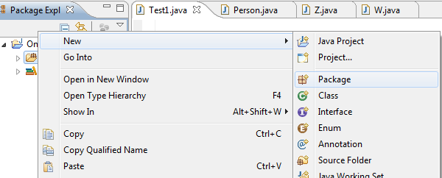
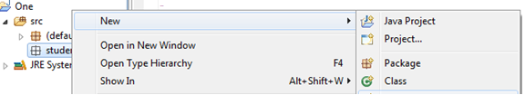
Package in Eclipse
Create a package
Right click on the “src” and click on New→Package.
Enter the package name and click finish
Create a class inside the package
Right click on the newly created package
and click on New→Class.
Rest is the same.
The IDE will automatically find the packages
in the same project. Compilation and execution is
simple and straight forward from IDE.

Slide 51
Additional points about package
A package is always defined as a separate folder having the same name as the package name.
Store all the classes in that package folder.
All classes of the package which we wish to access outside the package must be declared public.
All classes within the package must have the package statement as its first line.
All classes of the package must be compiled before use (So that they are error free).

Slide 52
import keyword
‘import’ keyword is used to import built-in and user-defined packages into your java source file so that your class can refer to a class that is in another package by directly using its name.
There are 3 different ways to refer to any class that is present in a different package:
Using fully qualified name (But this is not a good practice.)
Ex : pack.A obj = new pack.A(); //using fully qualified name
To import only the class/classes you want to use
If you import packagename.classname then only the class with name classname in the package with name packagename will be available for use.
Ex : import pack.A;
To import all the classes from a particular package
packagename.*, then all the classes and interfaces of this package will be accessible but the classes and interface inside the subpackages will not be available for use.
Ex : import learnjava.*;

Slide 53
Java static import
Static import allows you to access the static member of a class directly without using the fully qualified name.
If you are going to use static variables and methods only then use static imports.
Example : import static java.lang.Math.*

Slide 54
Java Code Conventions
All source files should begin with comment.
/*
* Classname
*
* Version info
*
* Copyright notice
*/
Package and Import Statements
The first non-comment line of most Java source files is a package statement.
After that, import statements can follow. For example:
package com.hcl;
import com.hcl.fs.Account;

Slide 55
Java Code Conventions
Indentation
Four spaces should be used as the unit of indentation.
Line Length
Avoid lines longer than 80 characters.
Wrapping Lines
When an expression will not fit on a single line, break it according to these general principles:
Break after a comma.
Break before an operator.
Prefer higher-level breaks to lower-level breaks.
Align the new line with the beginning of the expression at the same level on the previous line.
If the above rules lead to confusing code or to code that’s squished up against the right margin, just indent 8 spaces instead.

Slide 56
Java Code Conventions
Comments
Comments are delimited by /*...*/, and //.
Documentation comments are delimited by /**...*/.
Implementation comments are mean for commenting out code or for comments about the particular implementation.
Doc comments are meant to describe the specification of the code, from an implementation-free perspective. to be read by developers who might not necessarily have the source code at hand.
Initialization
Initialize local variables where they’re declared.
Class and Interface Declarations
When coding Java classes and interfaces, the following formatting rules should be followed:
No space between a method name and the parenthesis “(“ starting its parameter list.
Open brace “{” appears at the end of the same line as the declaration statement.
Closing brace “}” starts a line by itself indented to match its corresponding opening statement, except when it is a null statement the “}” should appear immediately after the “{“

Slide 57
Java Code Conventions
return Statements
A return statement with a value should not use parentheses unless they make the return value more obvious. Ex : return “Thank you” ;
if, if-else, if-else-if-else Statements
The if-else class of statements should have the following form:
if (condition) {
statements;
}
if (condition) {
statements;
} else {
statements;
}
if (condition) {
statements;
} else if (condition) {
statements;
} else if (condition) {
statements;
}

Slide 58
Java Code Conventions
White Space
Two blank lines should always be used in the following circumstances:
Between sections of a source file
Between class and interface definitions
One blank line should always be used in the following circumstances:
Between methods .
Between the local variables in a method and its first statement.
Between logical sections inside a method to improve readability.

Slide 59
Java Code Conventions
Naming Conventions
Class names
should be nouns, in mixed case with the first letter of each internal word capitalized.
Try to keep your class names simple and descriptive.
Use whole words—avoid acronyms and abbreviations. Ex : class EmployeeDetails;
Interfaces
Interface names should be capitalized like class names. Ex : interface RasterDelegate;
Methods
Methods should be verbs, in mixed case with the first letter lowercase, with the first letter of each internal word capitalized. Ex : getBackground() { .. }
Variables
Except for variables, all instance, class, and class constants are in mixed case with a lowercase first letter.
Internal words start with capital letters.
Variable names should be short yet meaningful. Ex : private float salary;

Slide 60
Java Code Conventions
Constants
The names of variables declared class constants and of ANSI constants should be all uppercase with words separated by underscores (“_”). Ex : final int MIN_WIDTH = 4;
Referring to Class Variables and Methods
Avoid using an object to access a class (static) variable or method. Use a class name instead. Example:
classMethod(); //OK
AClass.classMethod(); //OK
anObject.classMethod(); //AVOID!
Variable Assignments
Avoid assigning several variables to the same value in a single statement.
Ex : int number1 = number 2 = 10 ; // AVOID!
Notes:
http://www.oracle.com/technetwork/java/codeconventions-150003.pdf

Slide 61
Java.lang.System class in Java
System class are standard input, standard output, and error output streams.
public static final InputStream in: The “standard” input stream. This stream is already open and ready to supply input data. Typically this stream corresponds to keyboard input or another input source specified by the host environment or user.
public static final PrintStream out: The “standard” output stream. This stream is already open and ready to accept output data. Typically this stream corresponds to display output or another output destination specified by the host environment or user.
public static final PrintStream err: The “standard” error output stream.

Slide 62
JAR
JAR(java archive) is a file that has a collection of the class files required for the application.
It helps us distribute classes for the application easily and also helps in setting the classpath.
Important thing about the jar file is that it maintains the directory structure.
So if we want a class Student.class to be inside student directory that can be maintained in the jar file.
jar command can be used to create and update a jar file.
It can also be used to extract a jar file.

Slide 63
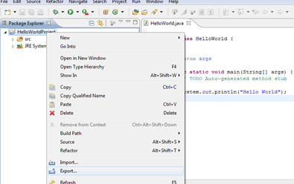
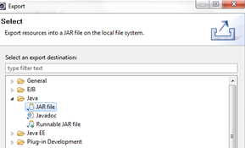
Create a jar in Eclipse
To run your Java program outside of Eclipse you need to export it as a jar file. A jar file is the standard distribution format for Java applications.
Step 1: Select your project, right click on it and select Export.
Select the project and specify the export destination and a name for the jar file. Select Finish.
This jar file can be executed by including it in the classpath.
Step 2: Select JAR File from the Export window. Select Next

Slide 64
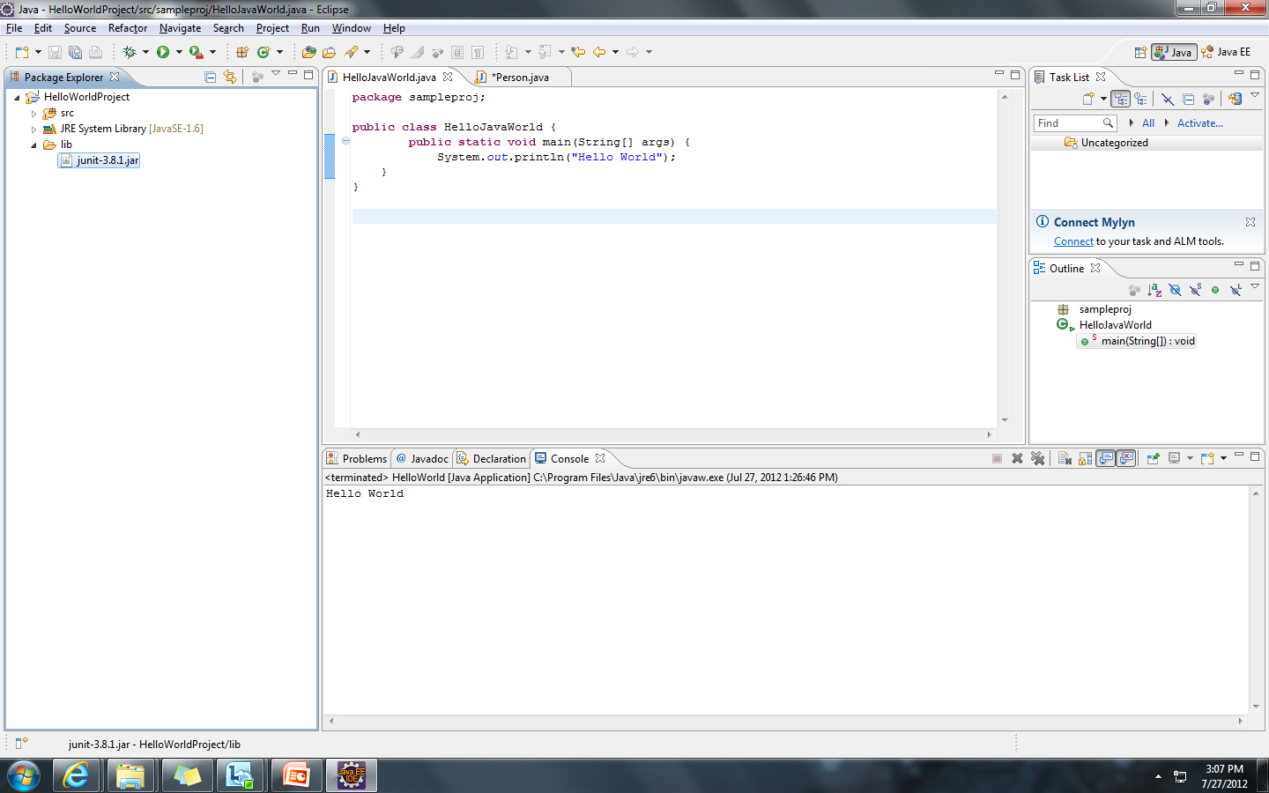
Using Jars (Libraries)
The Steps to add a library (.jar) to the project are as follows.
Step 1: Import the jar to the project by selecting File → Import → General → File System. Select the jar and select the folder lib as target. Alternatively, just copy and paste the jar file into the "lib" folder.

Slide 65
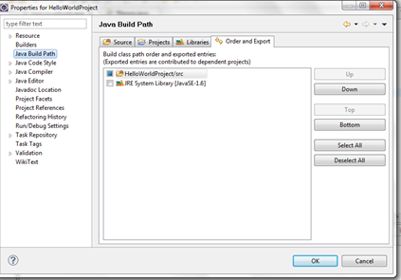
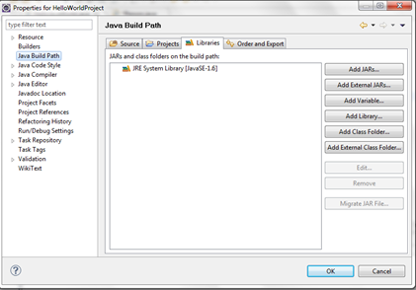
Using Jars (Libraries)
Step 2: Right click on the project and select Properties and select Java Build Path.
Step 3: Select “Add JARs” or “Add External JARs”

Slide 66
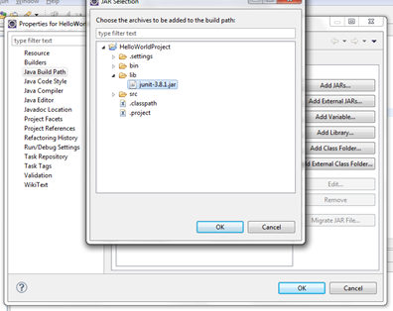
Using Jars (Libraries)
Step 4: Select the Jar to be added and click OK

Slide 67
References & Further Studies
https://docs.oracle.com/javase/tutorial/java/package/usepkgs.html
https://www.tutorialspoint.com/java/java_packages.htm

